Slide 1
Exploring Heart Disease Prediction Using Tensorflow
Author: Shaquille Hall
CS613 - Machine Learning
Final Presentation

Slide 2
Fun Facts
~655,000 Americans die from heart disease yearly
~9m people died from heart disease globally in 2016
~17m people die every year
Notes:
Let’s review some facts.

Slide 3
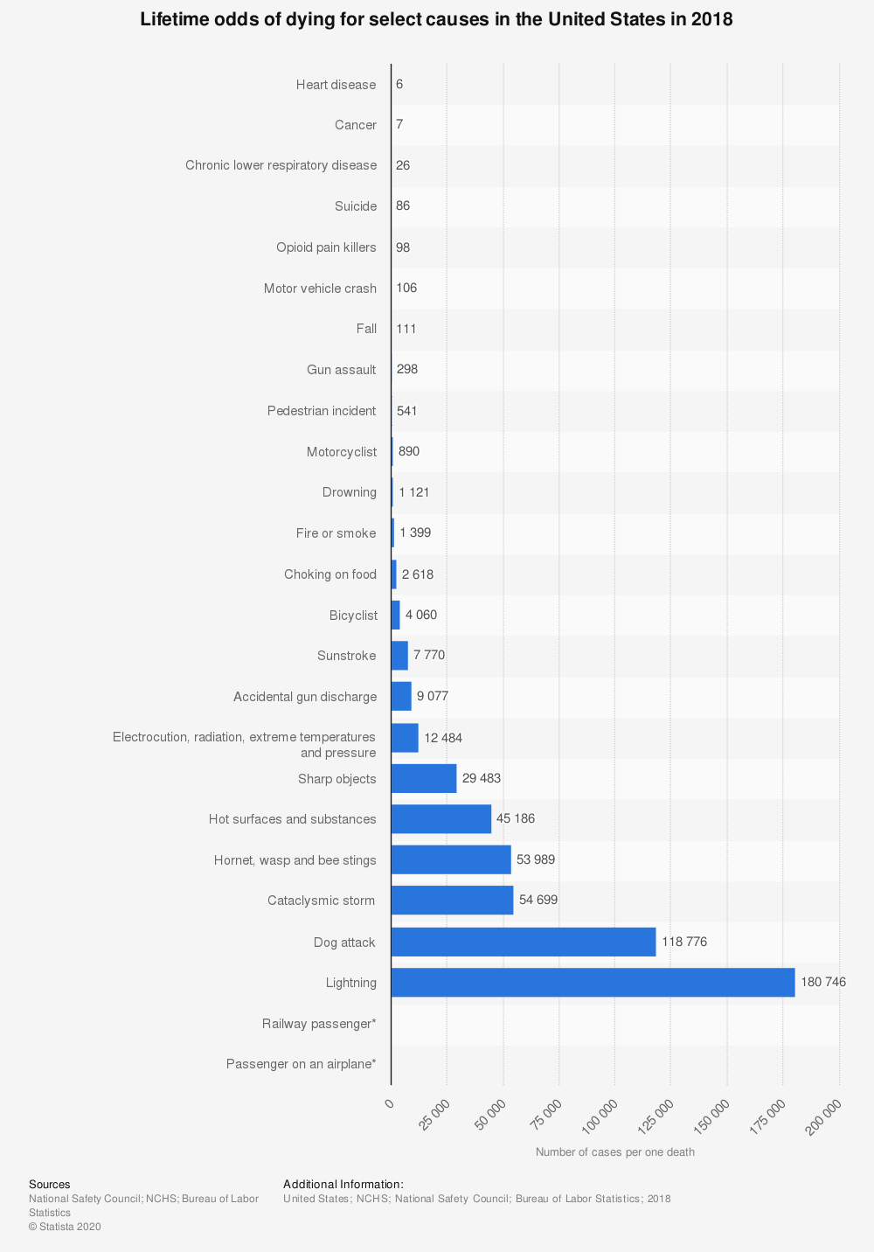

Slide 4
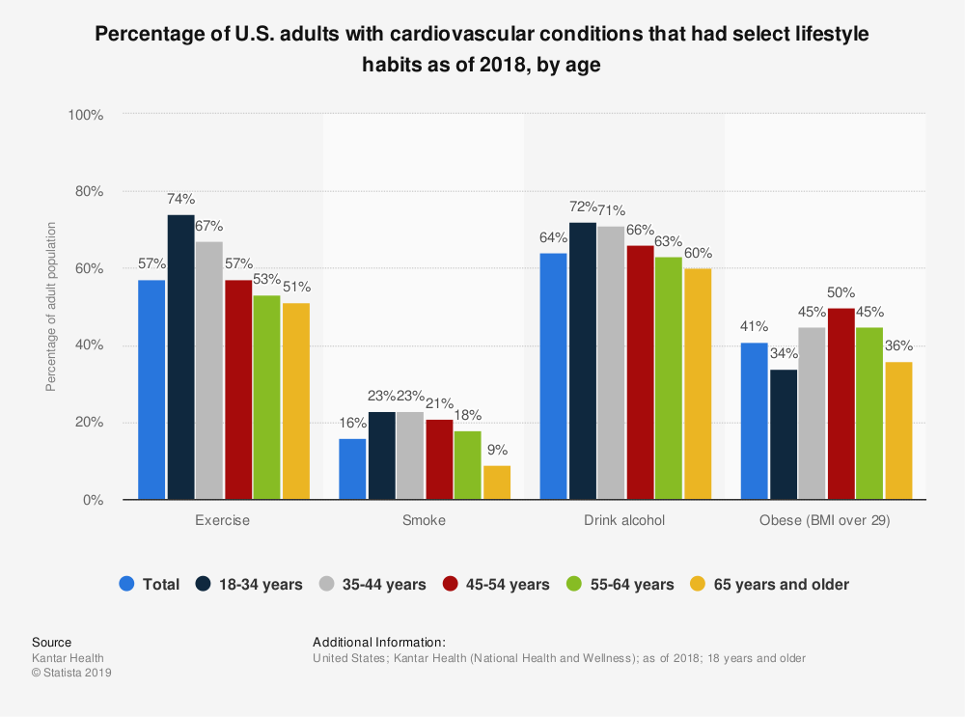

Slide 5
Problem Statement
- - Heart disease is a huge deal!

Slide 6
Goals
Explore the relationship between heart disease and some of its known influencers using Tensorflow
Derive useful models for predicting heart disease based on known ML algorithms
Gain a deeper understanding of ML methodologies
Gain an understanding of a popular machine learning library
Examine the compute performance of machine learning models

Slide 7
Primary Questions
Of those selected, which Tensorflow approach will yield the best results (accuracy)?
What compute resources will Tensorflow consume to execute each algorithm?
Does Tensorflow produce results aligned with scientifically backed data?

Slide 8
Data Sources
Heart Disease dataset: https://archive.ics.uci.edu/ml/datasets/Heart+Disease
4 Datasets; ~200-300 samples each; ~14 attributes each:
Cleveland Clinic Foundation
Hungarian Institute of Cardiology, Budapest
V.A. Medical Center, Long Beach, CA
University Hospital, Zurich, Switzerland

Slide 9
Related Work
P. Wilson, R. D’Agostino, D. Levy, A. Belanger, H. Silbershatz, and W. Kannel, “Prediction of Coronary Heart Disease Using Risk Factor Categories,” in AHA Journals, vol. 97,
S. Mohan, C. Thirumalai and G. Srivastava, "Effective Heart Disease Prediction Using Hybrid Machine Learning Techniques," in IEEE Access, vol. 7
S. Pouriyeh, S. Vahid, G. Sannino, G. De Pietro, H. Arabnia and J. Gutierrez, "A comprehensive investigation and comparison of Machine Learning Techniques in the domain of heart disease," 2017 IEEE Symposium on Computers and Communications (ISCC), Heraklion, 2017
Notes:
I didn’t particularly hinge on any of these, but these are other works in this space.

Slide 10
Approach
Naive Solution:
Logistic Regression
KNN
Gradient Boosting
Notes:
I chose these because they each take a different approach
to supervised learning,
and because both Tensorflow and scikit-learn have built-in classifiers,
or estimators for each one. This allows for near equal comparisons.

Slide 11
Tools
Tensorflow
scikit-learn
Google Colab
Notes:
scikit-learn was treated as the control; it is a more mature platform

Slide 12
The Case of The Missing Data
Unexpected, but not uncommon
Missing Completely at Random
Missing at Random
Missing Not at Random
List-wise Deletion
Median Imputation
Notes:
I’ve not done any work with analytical data sets before, so the idea of encountering missing information didn’t even cross my mind.
I realized quickly how naive of me that was, and apparently how this is a pretty common thing, and an import issue to understand. So much so that there are entire publications on the matter.
After some digging I came across the idea of data imputation, and chose median substitution. Using the mean is also pretty common here, but I chose the median to avoid being influenced by outlier data points in unfamiliar datasets.
With exception of the Cleveland Dataset
if number of missing values > 50% number of values in the column
– remove the entire column • else
– impute the missing values with mean of the values present

Slide 13
The Combined Dataset
300 samples was not enough
Once each original dataset was retrieved, pruned and imputed, I combined them for a larger dataset.
(920, 10)
Missing Attributes:
Fasting Blood Sugar
Slope
Ca
Thalium
Notes:
These attributes (specifically the last three) were already missing from at least two of the smaller datasets.

Slide 14
Le Experiment

Slide 15
Logistic Regression
Simple logistic regression
Euclidean Distance
Class substitution
From 5 outputs, to 1
Notes:
The original datasets classify the target columns into one of 5 classes; but I only wanted to detect binary precence.
Class substitution to make it easier to build a Tensorflow model. scikit-learn handles multi-class logistic regression pretty easily (it’s a parameter flag), Tensorflow not so much

Slide 16
K-Nearest Neighbors
Determining optimal value for K
Execute KNN using train and validate sets, and take the K associated with the highest accuracy
Euclidean Distance

Slide 17
Gradient Boosting
New concept to me. But I liked it enough to give it a whirl
Default values
However 0.1 != 0.01
Notes:
0.01 for sklearn and tf both yield better results.

Slide 18
Monitoring
CPUs
GPUs
Ram Used
Ram Total
Ram Utilization
Notes:
GPUtil, PSUtil

Slide 19
Le Results

Slide 20
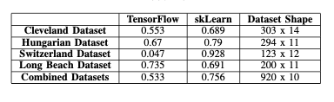
Accuracy
Similar results for all datasets (including combined dataset)
Except Logistic Regression
Tensorflow accuracy ~20% less than sklearn

Slide 21
Performance Metrics
CPU: Constant at 2
GPU: Tensorflow usage varied, scikit-learn never triggered
https://scikit-learn.org/stable/faq.html#will-you-add-gpu-support
Ram Total:
Constant per algorithm, platform independent
Ram Usage:
Similar per algorithm; scikit-learn uses more
Ram Utilization:
Similar per algorithm; scikit-learn uses more
Notes:
scikit-learn does not support GPU usage

Slide 22
Gradient Boosting Resource Consumption
Notes:
Without building an entire monitoring suite, these are the graphs.

Slide 23
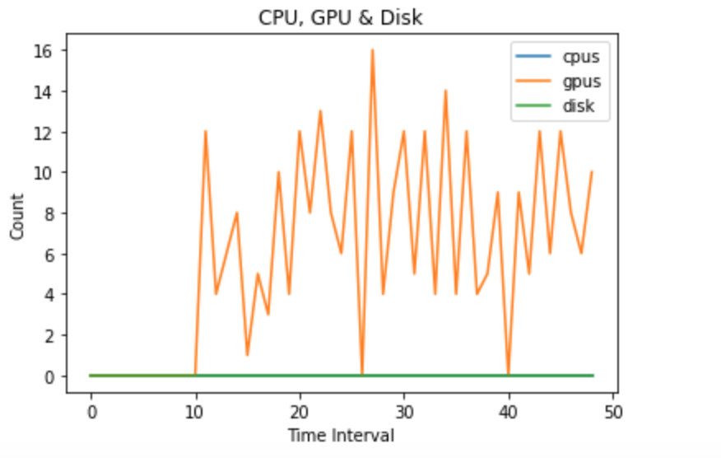

Slide 24
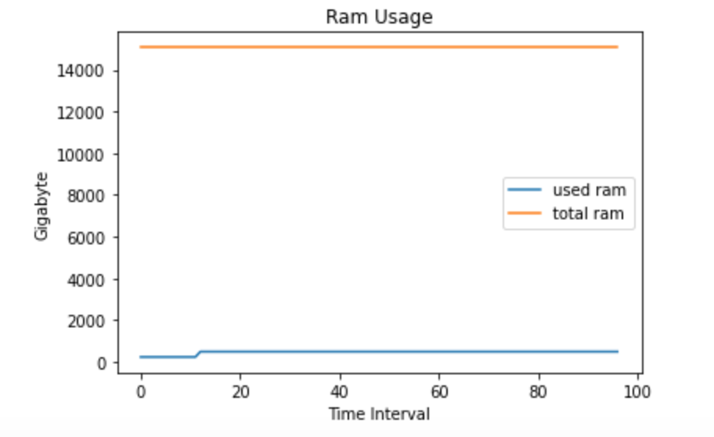

Slide 25
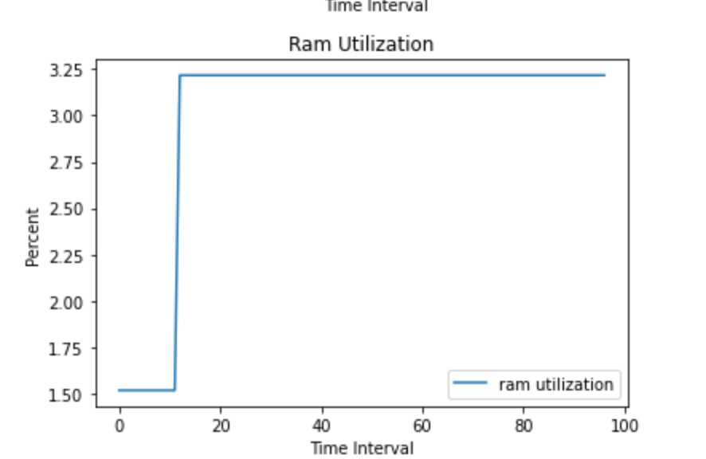

Slide 26
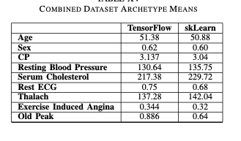
Archetypes
Notes:
Age is low,
CP / Angina is inconclusive
RBP is a true indicator
Chol == T
Rest ECG is inconclusive
Thalach = T
Exang is inconclusive
Oldpeak is inconclusive

Slide 27
Thanks

Slide 28
Works Cited
A. Nowbar, BSc, M. Gitto, J. Howard, D. Francis, and R. Al-Lamee, Mortality From Ischemic Heart Disease, “Mortality From Ischemic Heart Disease”, in AHAJournals, 2019
Centers for Disease Control. (2020, September). Heart Disease Facts. https://www.cdc.gov/heartdisease/facts.htm#:~:text=Heart%20Disease%20in%20the%20United%20States&text=One%20person%20dies%20every%2036,1%20in%20every%204%20deaths.
Chicco, D., Jurman, G. Machine learning can predict survival of patients with heart failure from serum creatinine and ejection fraction alone. BMC Med Inform Decis Mak 20, 16 (2020). https://doi.org/10.1186/s12911-020-1023-5
Statista, “Cardiovascular Disease in the US”, Statista, 2020
Notes:
No questions because this is recorded.

Slide 29
Kantar Health. (September 11, 2018). Percentage of U.S. adults with cardiovascular conditions that had select lifestyle habits as of 2018, by age [Graph]. In Statista. Retrieved November 13, 2020, from https://www-statista-com.ezproxy2.library.drexel.edu/statistics/757891/us-cardiovascular-patients-lifestyle-age/

